Slide 1
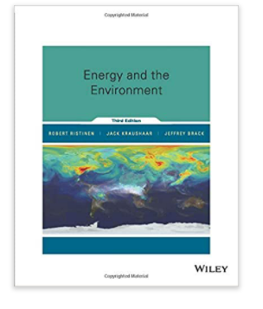
Food Energy slides from Physics 140, Winona State University
Nathan Moore, PhD
http://course1.winona.edu/nmoore
https://ntmoore.github.io/
Textbook: Energy and the Environment Ristinen, Kraushaar, Brack
3 credits, 1 semester
Course description:
Course outcomes:

Slide 2
How much food (kcals) does a person need each year?
Reminder, 1kcal = 1Calorie

Slide 3
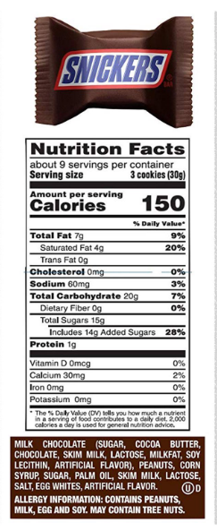
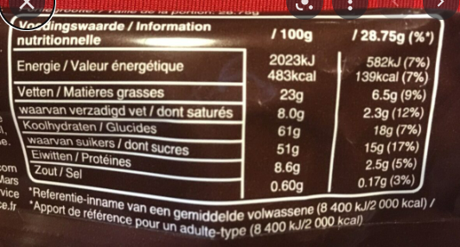


How much food energy do you need each day?
Calories = kcals

Slide 4

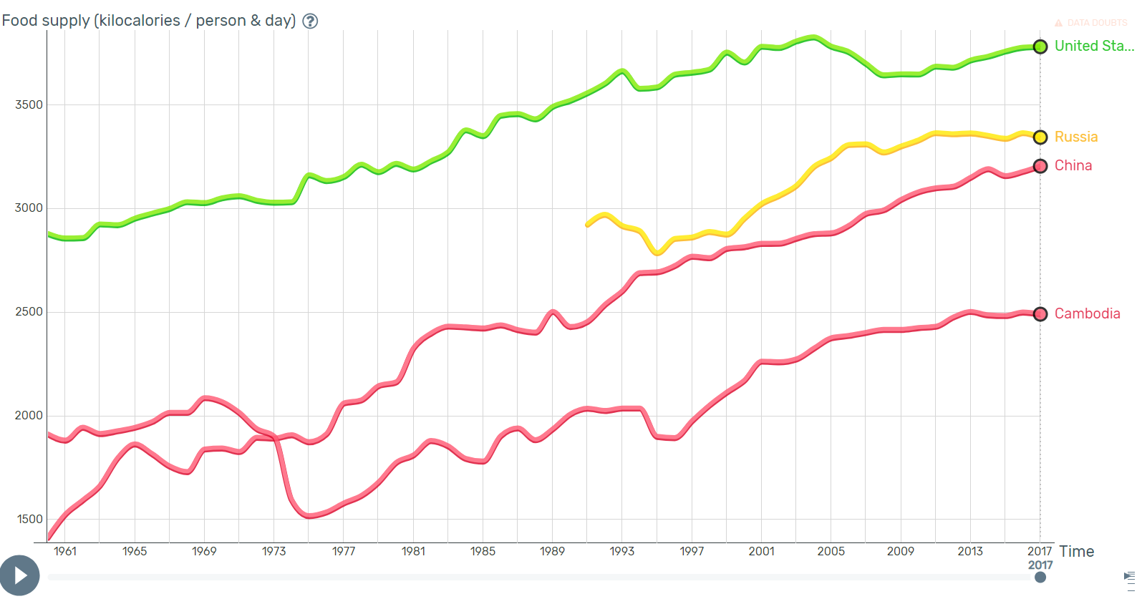
Look at country data on Gapminder.org
Notes:
https://www.gapminder.org/tools/#$model$markers$line$data$filter$dimensions$country$country$/$in@=usa&=chn&=rus&=khm;;;;;;&encoding$y$data$concept=food_supply_kilocalories_per_person_and_day&space@=country&=time;;&scale$type:null&domain:null&zoomed:null;;&frame$value=2018;;;;;&chart-type=linechart&url=v1

Slide 5
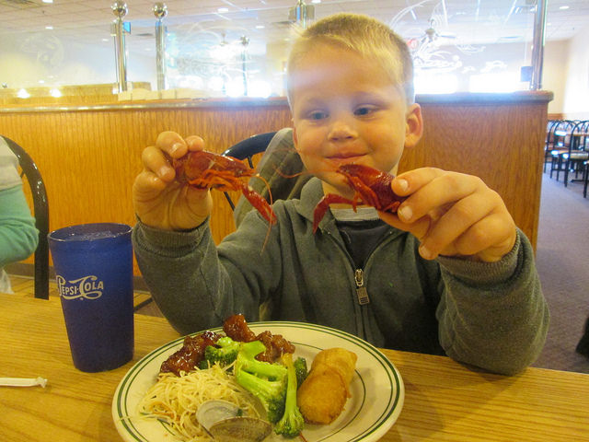
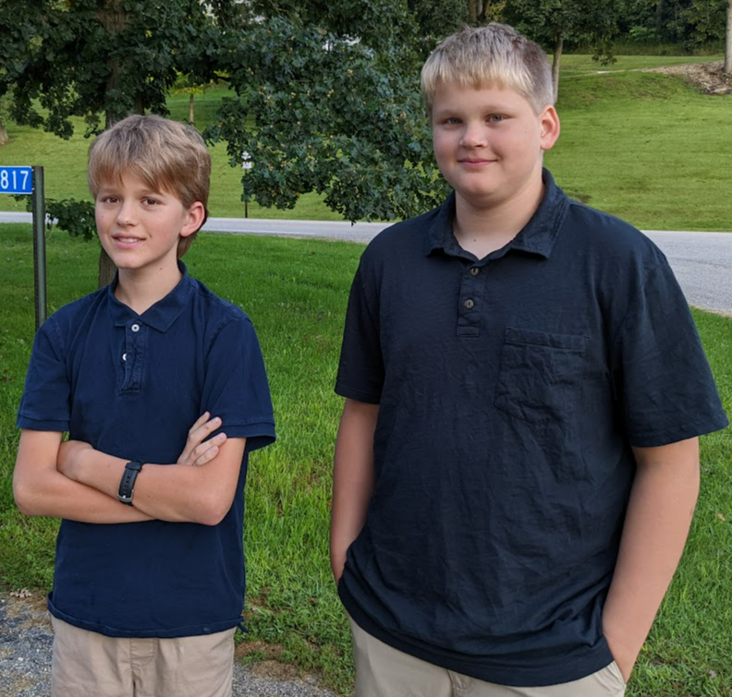
What happens to food energy?
1 Calorie (kcal) raises the temp of 1kg water, +1deg C
3000kcal goes into 85kg of water

Slide 6
How much food (kcals) does the US need each year?
Notes:
About 350M ppl

Slide 7
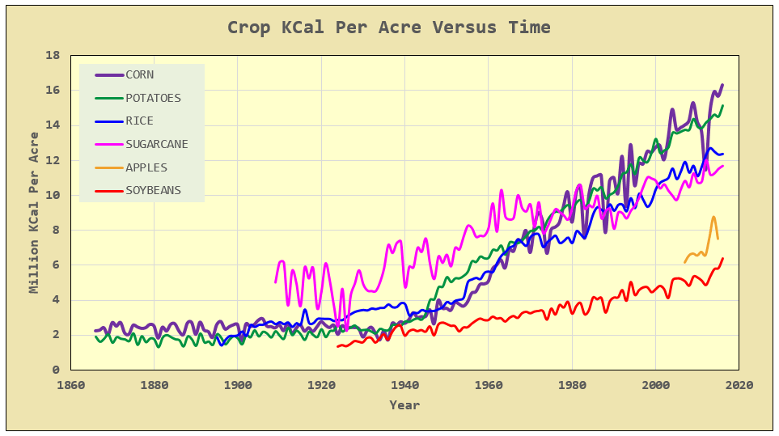
How do we get those kcals?
Notes:
Via math encounters blog, USDA data

Slide 8
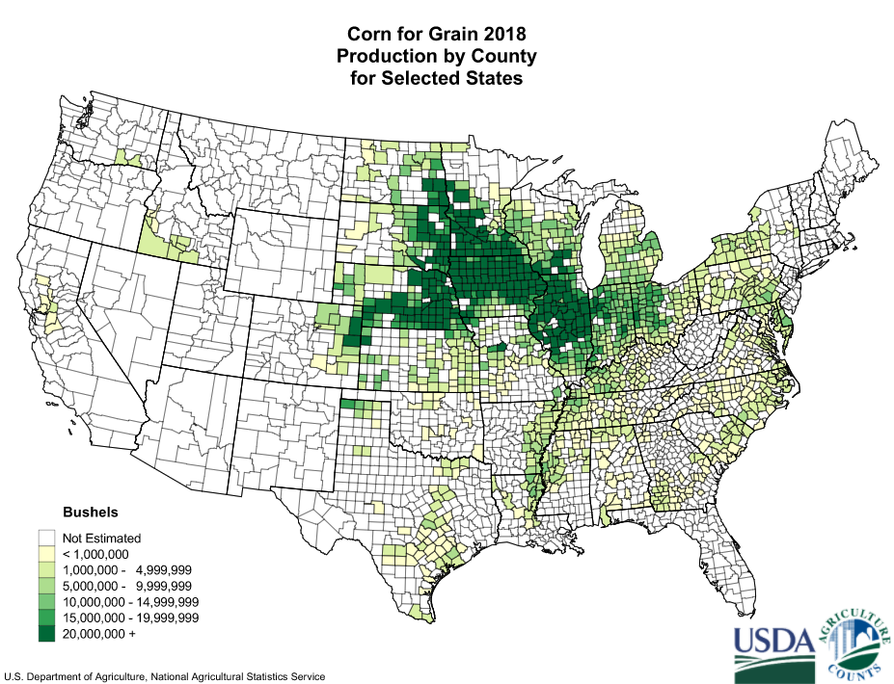
Corn
@15M kcal/acre: if we only fed the US corn, how much area would be needed?
Notes:
https://en.wikipedia.org/wiki/Corn_Belt 330M M kcals means about 22M acres
Total area: Iowa 36M acres, IL 37M acres

Slide 9
How much land area does this require?

Slide 10
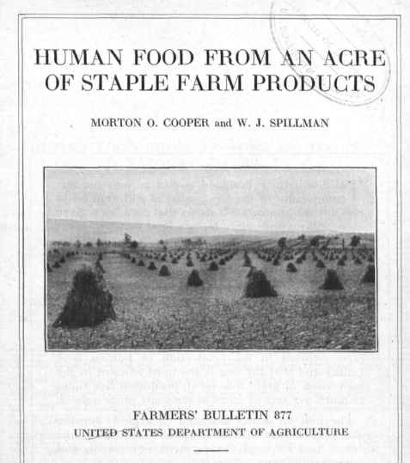
What if you want to DIY?
Notes:
1917, WWI, non-chemical horse/ox/manure-based agriculture

Slide 11
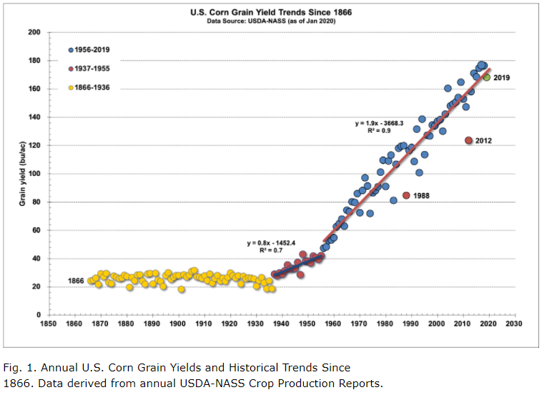
Notes:
https://www.agry.purdue.edu/ext/corn/news/timeless/YieldTrends.html

Slide 12
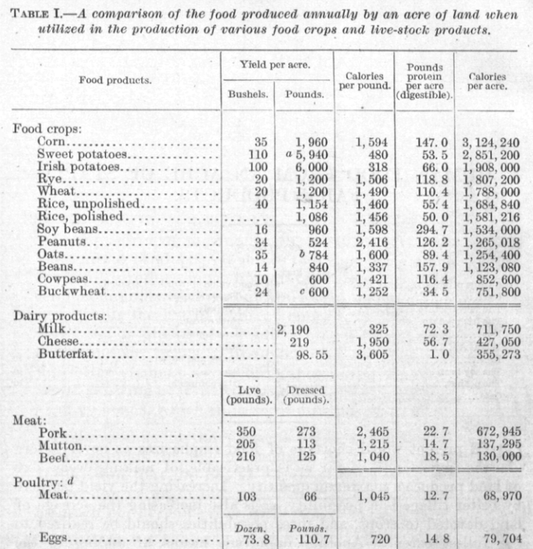
Notes:
Note the poor feed conversion efficiency of crops to meat. FYI, crickets are about 1:1 while modern “broiler” chickens are about 1.6:1

Slide 13
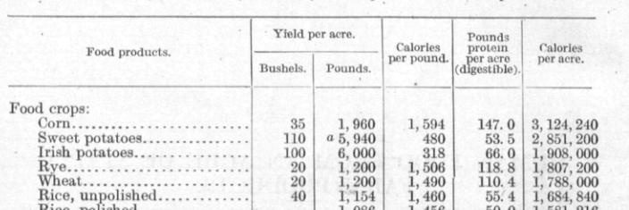
6 people, 1 year, how many acres of potatoes?
Notes:
Maybe ½ acre per person with potatoes?

Slide 14
In terms of Winona (maps)

Slide 15
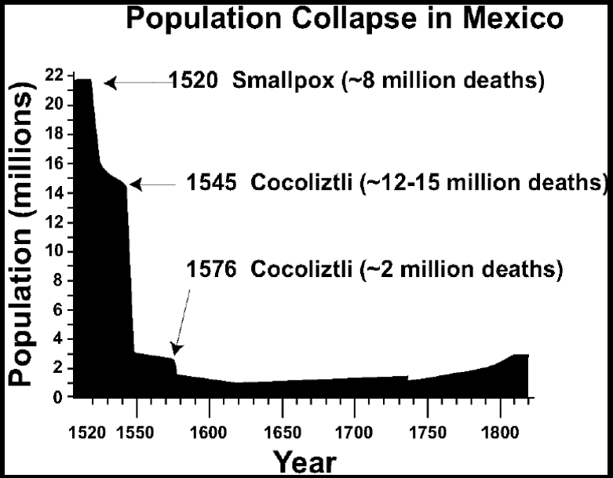
Related Mystery
In 1491 there were ~50M people in N. America and ~70M people in Europe. The Americans were a primarily agricultural society. What did they eat?
See the readings for more
Notes:
For a reference on the population estimates, see https://uwpress.wisc.edu/books/0289.htm
Graph from https://en.wikipedia.org/wiki/Population_history_of_indigenous_peoples_of_the_Americas

Slide 17
How much food (kcals) does the US need each year?
1 person 1M kcals/yer
350M M kcals /year
350 Trillion kcals/year

Slide 18
How do we get those kcals?
Notes:
Via math encounters blog, USDA data

Slide 19
Corn
@15M kcal/acre: if we only fed the US corn, how much area would be needed?
Iowa, 36M acres
Notes:
https://en.wikipedia.org/wiki/Corn_Belt 330M M kcals means about 22M acres
Total area: Iowa 36M acres, IL 37M acres

Slide 20
How much land area does this require?

Slide 21
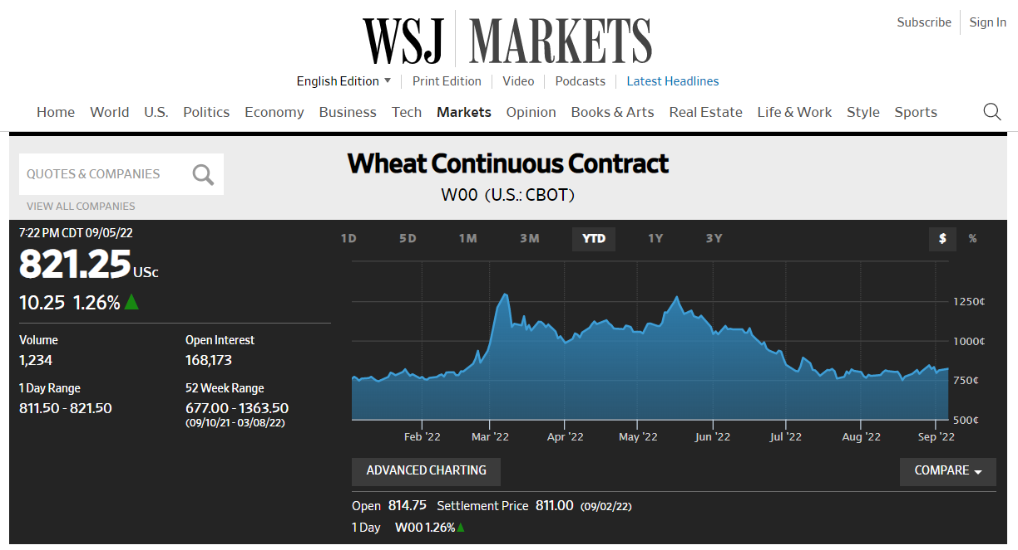
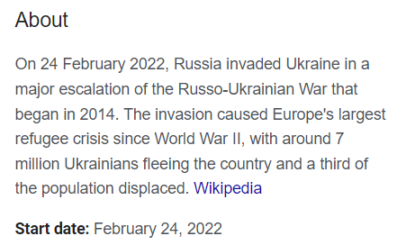
Start Here on 09-06 Week 03 readings Wheat and War in Ukraine
Notes:
https://en.wikipedia.org/wiki/2022_Russian_invasion_of_Ukraine
https://www.wsj.com/market-data/quotes/futures/W00
https://www.investopedia.com/articles/optioninvestor/07/grain_market.asp,
https://www.schwab.com/futures/wheat

Slide 22
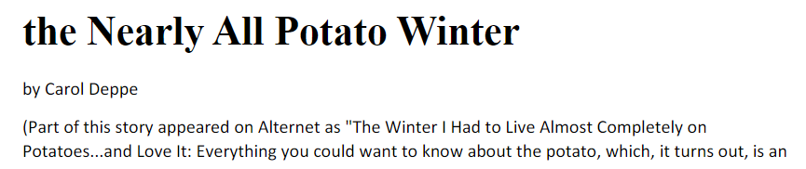
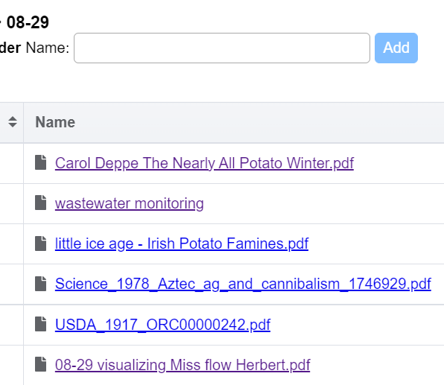
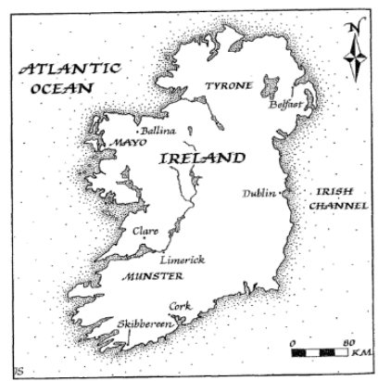
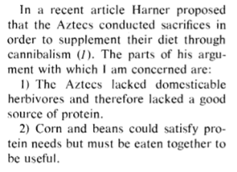
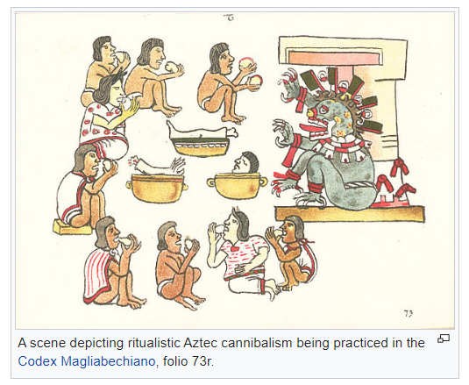
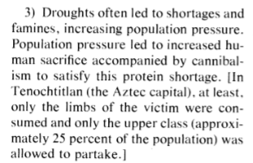
Week 02 readings Food and History
Notes:
https://en.wikipedia.org/wiki/Cannibalism_in_pre-Columbian_America

Slide 23
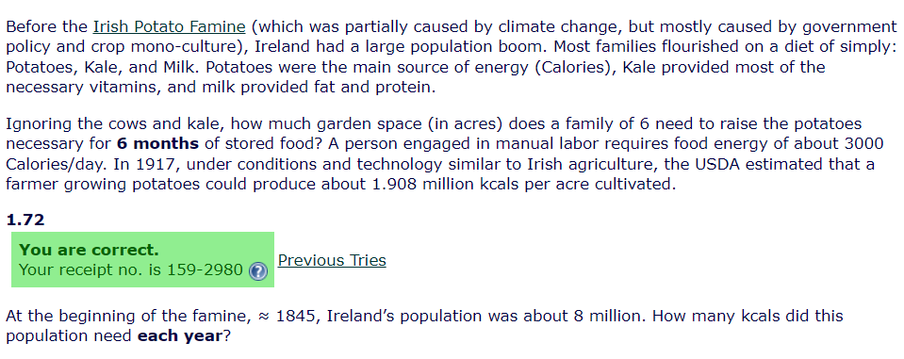














Slide 24
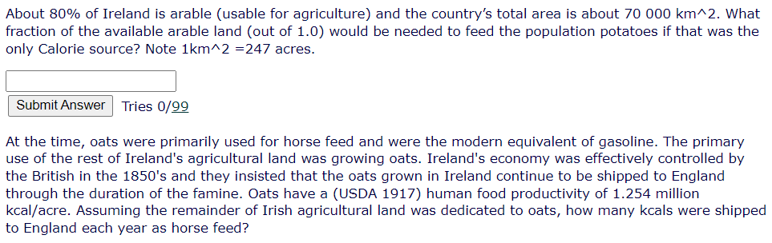









Slide 25







Slide 26
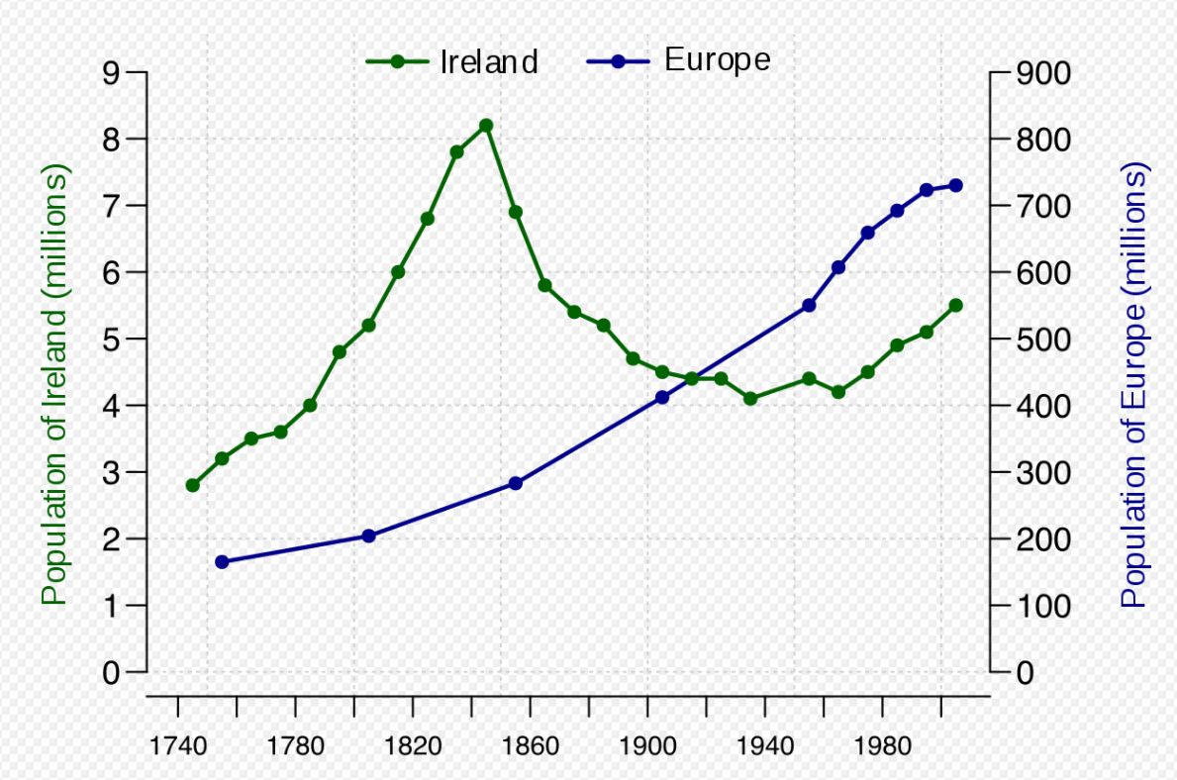

Notes:
https://en.wikipedia.org/wiki/Demographics_of_the_Republic_of_Ireland

Slide 27
What if you want to DIY?
Notes:
1917, WWI, non-chemical horse/ox/manure-based agriculture

Slide 28
Notes:
https://www.agry.purdue.edu/ext/corn/news/timeless/YieldTrends.html

Slide 29
Notes:
Note the poor feed conversion efficiency of crops to meat. FYI, crickets are about 1:1 while modern “broiler” chickens are about 1.6:1

Slide 30

6 people, 1 year, how many acres of potatoes?
Notes:
Maybe ½ acre per person with potatoes?

Slide 31
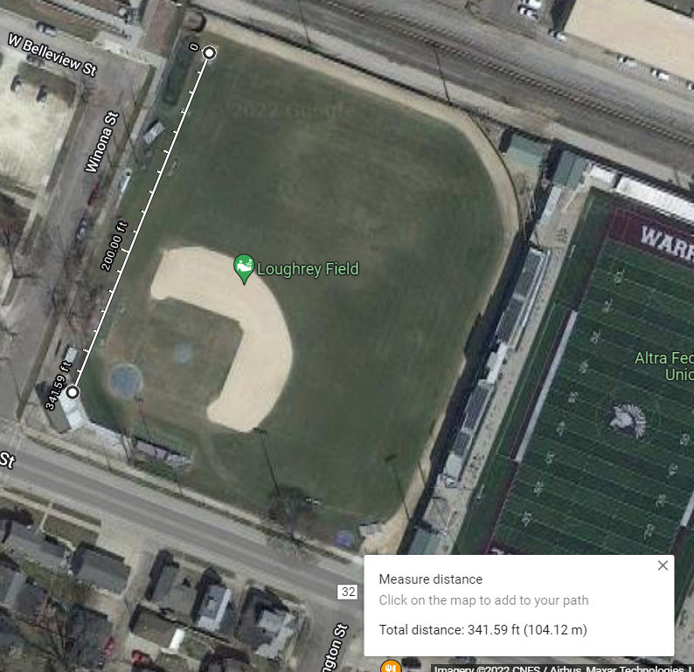



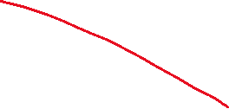

In terms of Winona (maps)

Slide 32
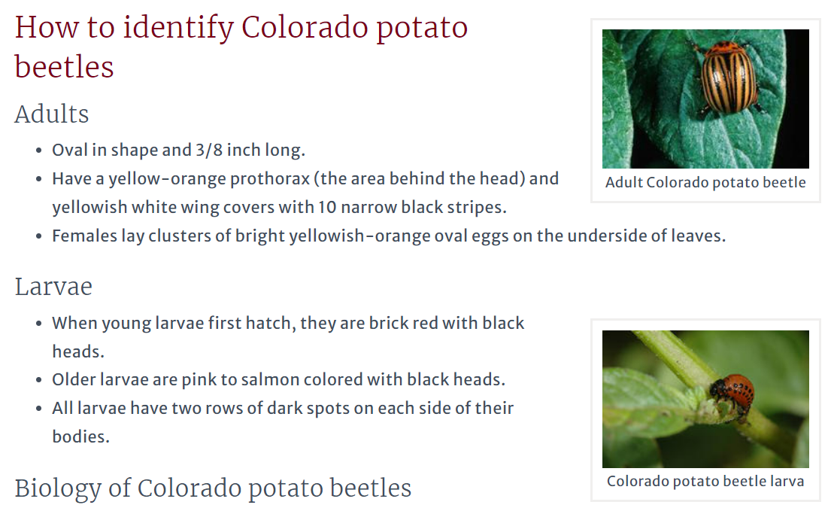
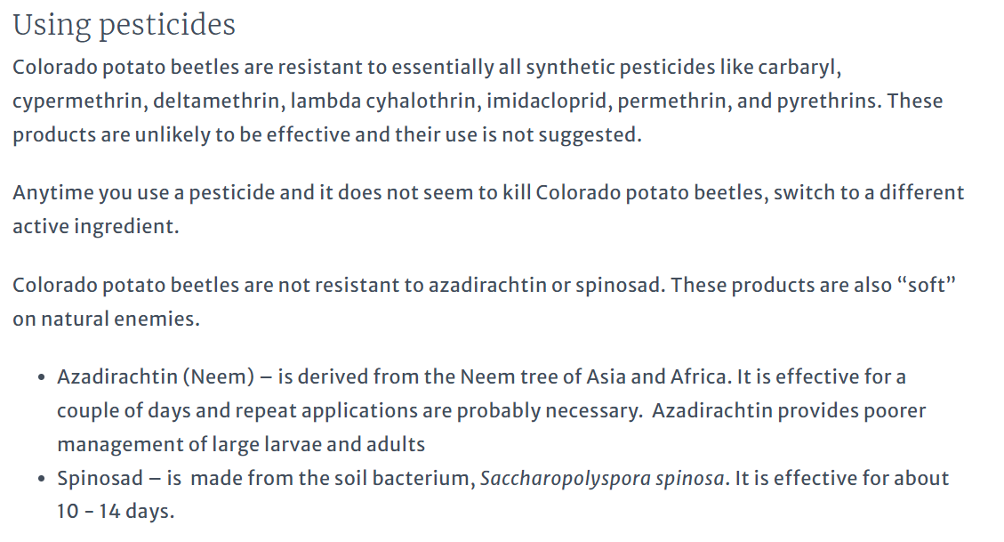
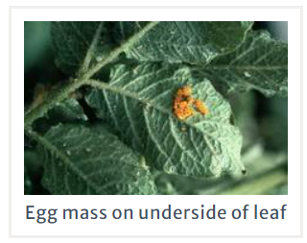
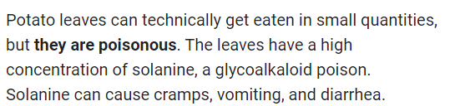
Notes:
https://extension.umn.edu/yard-and-garden-insects/colorado-potato-beetles
https://www.outdoorhappens.com/can-you-eat-potato-leaves-poisonous/

Slide 34
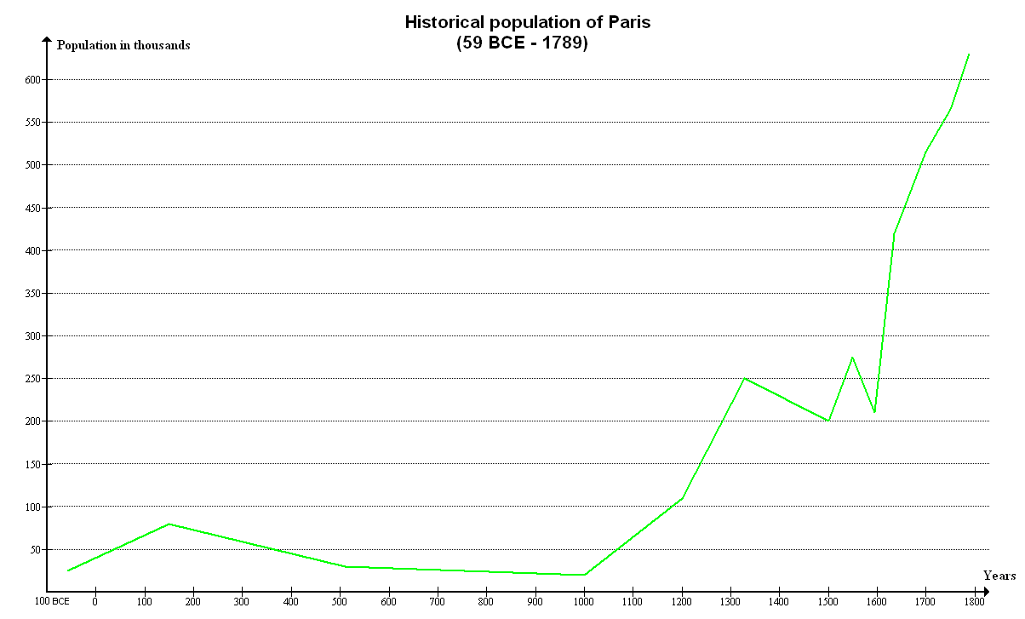

Related Mystery
In 1491 there were ~50M people in N. America and ~70M people in Europe. The Americans were a primarily agricultural society. What did they eat? (for 7 centuries!!!)
Start here 09-08
Tenochtitlan was 200-400k people!
Notes:
For a reference on the population estimates, see https://uwpress.wisc.edu/books/0289.htm
Graph from https://en.wikipedia.org/wiki/Population_history_of_indigenous_peoples_of_the_Americas

Slide 35
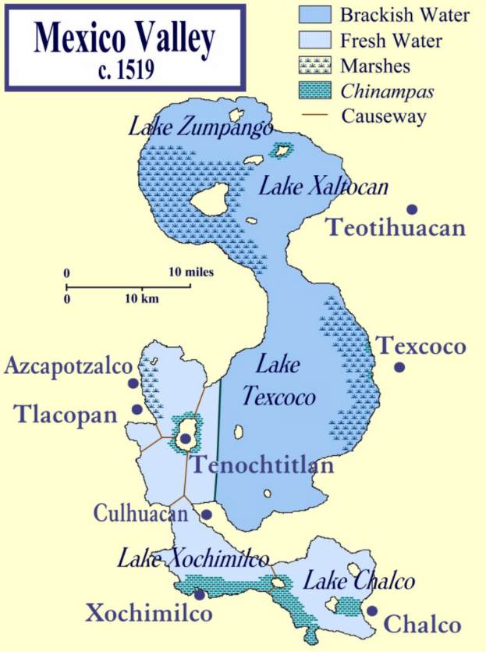
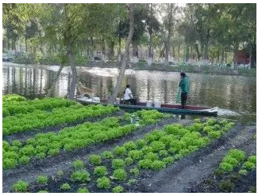
Notes:
“Chinampas were essentially man-made islands, raised bed gardens on the surface of Lake Texcoco’s shallow waters.”
https://www.historyonthenet.com/aztec-agriculture-floating-farms-fed-the-people
https://en.wikipedia.org/wiki/Chinampa

Slide 36
Notes:
“Chinampas were essentially man-made islands, raised bed gardens on the surface of Lake Texcoco’s shallow waters.”
https://www.historyonthenet.com/aztec-agriculture-floating-farms-fed-the-people
https://en.wikipedia.org/wiki/Chinampa

Slide 37
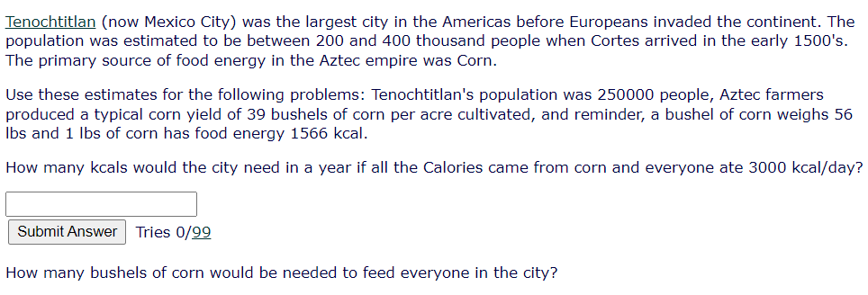








Slide 38
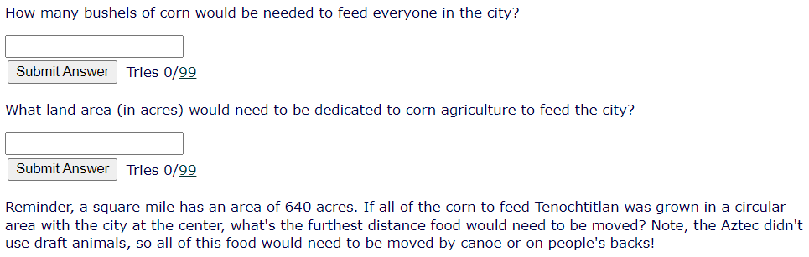
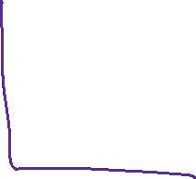









Slide 40
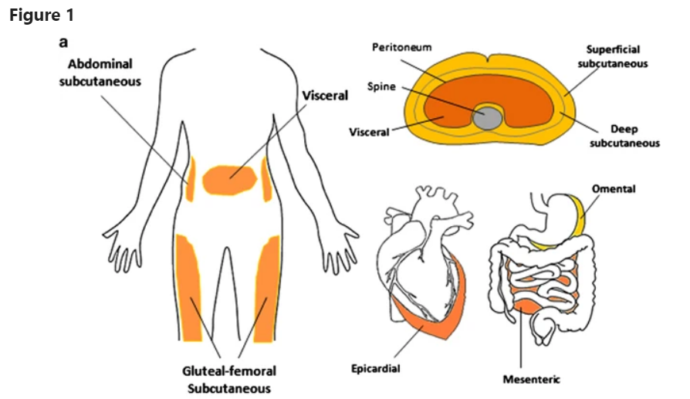

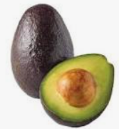
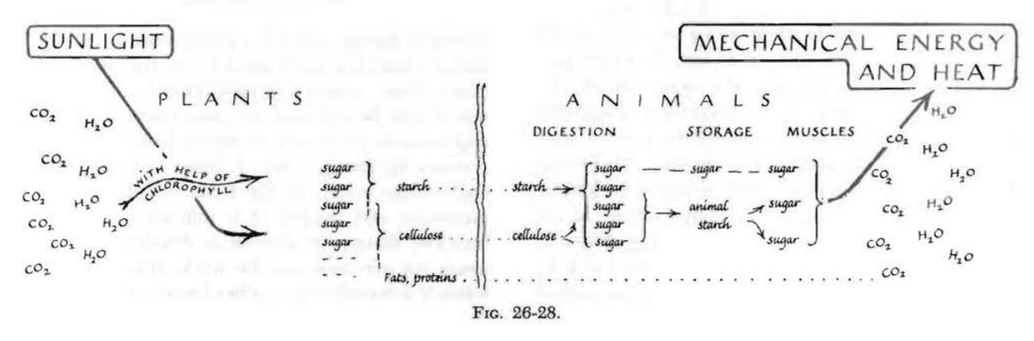
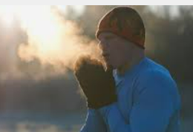
The Energy Principle
Energy can always be accounted for
Notes:
https://www.nature.com/articles/emm20165

Slide 41
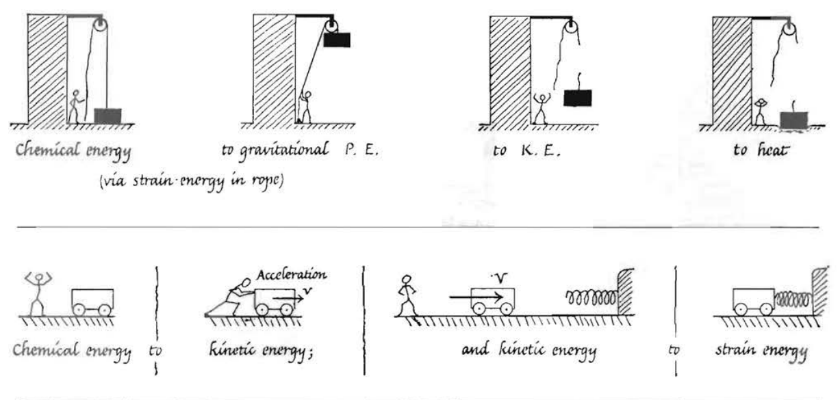
You don’t need math to tell useful stories!
Notes:
Image from “Physics for the Inquiring Mind” Eric Rogers

